Slide 1

Charlotte FC / UNCC Sports Analysis
Ethan Wacker, Jaren Robbins, Mubarak Sabakada, Anders Pierson

Slide 2
Expansion team first year performance
Expansion teams have performed well
Only two teams have made the playoffs
Attendance records broken
Atlanta United is the example a lot of teams try to follow

Slide 3
Charlotte FC year 1
Main goal is to have support from fanbase
Expectation is playoffs
Modeled after Atlanta United
Strive to be an example for soccer locally

Slide 4
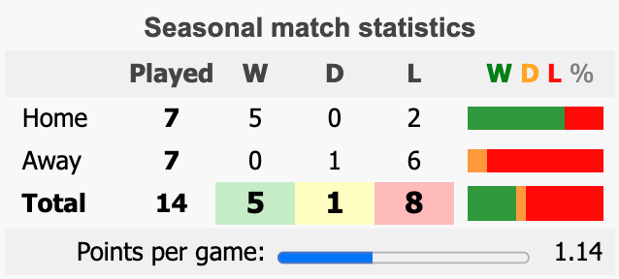

Slide 5
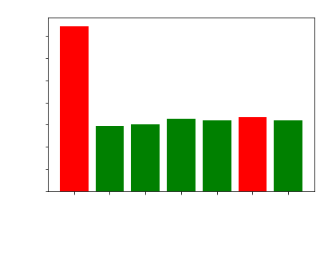
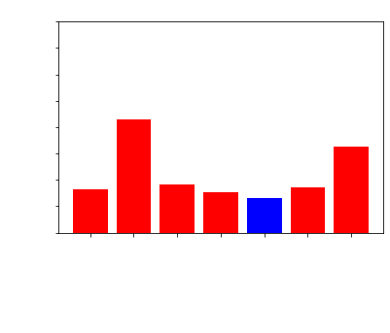
Notes:
W - green, D - blue, L - red

Slide 6
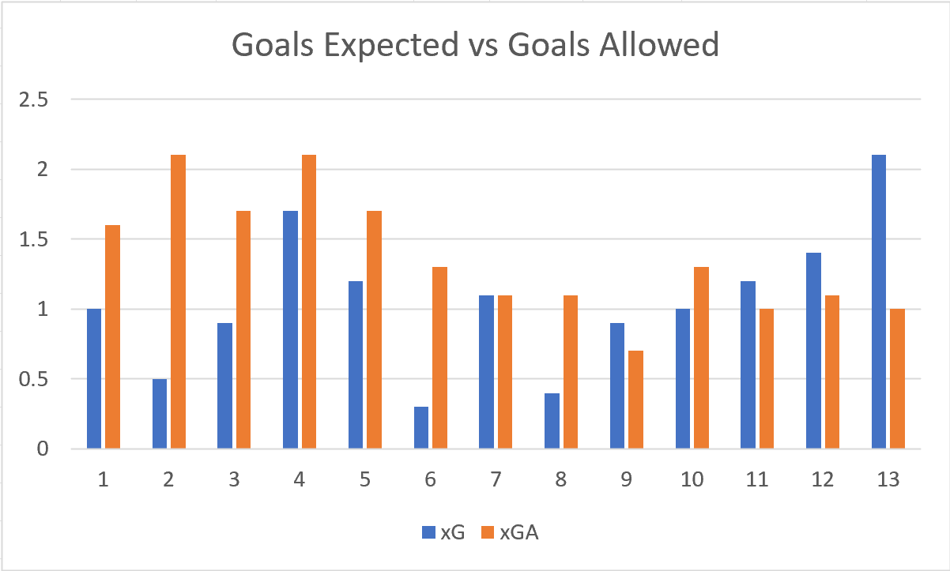
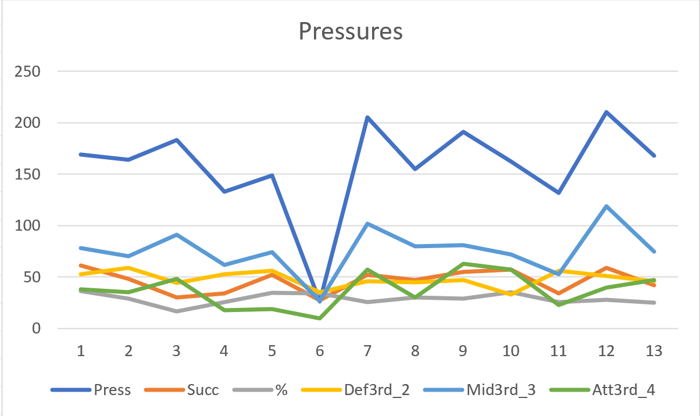

Slide 7
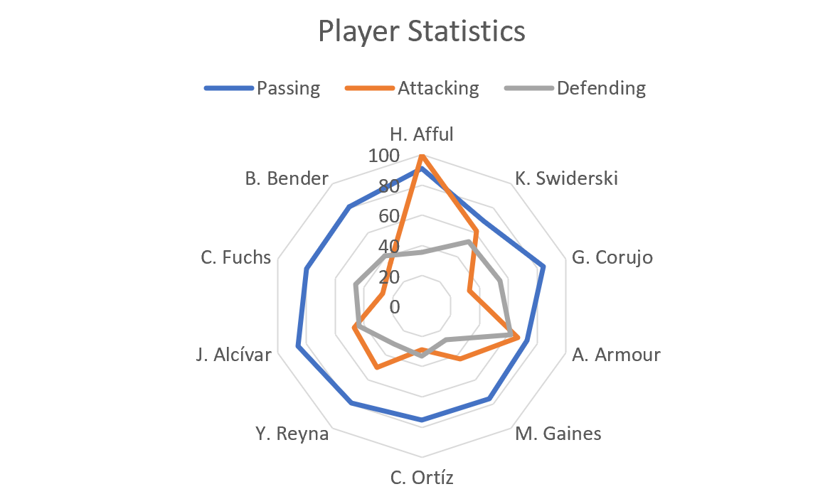
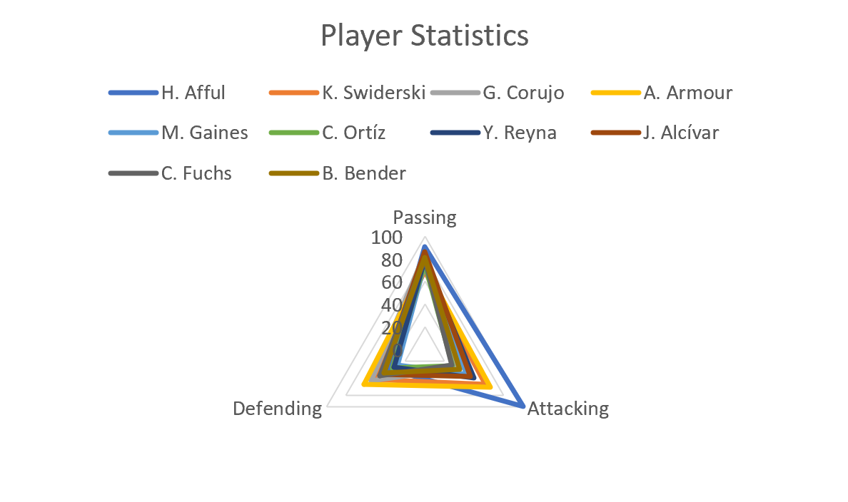

Slide 8
Goals scored at home
Out of Charlotte FC’s 12 goals scored this season 9 of their goals were scored at home
Have an average of 1.29 goals scored per game at home
2.14 points per game at home which is above the league average of 1.71 points per game at home
Charlotte FC has scored in both halves 43% of the time in home games which is tied for 6th highest in the MLS
Scored first 57% of the time at home

Slide 9
Goals scored on the road
Out of Charlotte FC’s 12 goals scored this season only 3 of their goals were scored on the road
Charlotte FC has an average of .5 goals scored per game on the road below the league average of 1.12 goals scored per game in away games
Points per game of .17 which in away games is well below the league average of 1.04 points scored per game in away games

Slide 10
Goals conceded at home
Out of the 16 goals Charlotte FC has conceded only 5 goals have been conceded at home
Charlotte FC had .71 goals conceded per game at home which is below the league average of 1.71 goals conceded per game at home
Only conceded a goal in both halves 14% of the time in home games
Opponents only scored first 43% of the time in away games

Slide 11
Goals conceded on the road
Out of the 16 goals Charlotte FC has conceded 11 goals have been conceded on the road
Charlotte FC had 1.83 goals conceded per game in away games which is above the league average of 1.61 goals conceded per game in away games
Conceded a goal in both halves 50% of the time in away games
Opponents scored first 83% of the time on the road

Slide 12
Sources
https://www.foxsports.com/stories/soccer/charlotte-fc-aiming-for-high-bar-set-by-mls-expansion-squads
https://www.mlssoccer.com/news/lessons-nashville-sc-inter-miami-how-mls-expansion-team-have-fared-year-no-1
https://fbref.com/en/squads/eb57545a/Charlotte-FC-Stats
https://www.soccerstats.com/team.asp?league=usa&stats=10-charlotte
https://www.espn.com/soccer/major-league-soccer/19/blog/post/3381411/the-goodthe-bad-and-the-ugly-of-mls-expansion-what-lafc-can-expect

Slide 13
Sources
https://www.mlssoccer.com/clubs/charlotte-fc/stats/#season=2022&competition=mls-regular-season&statType=defending&position=all
https://fbref.com/en/squads/eb57545a/2022/matchlogs/all_comps/schedule/Charlotte-FC-Scores-and-Fixtures-All-Competitions

